Slide 1
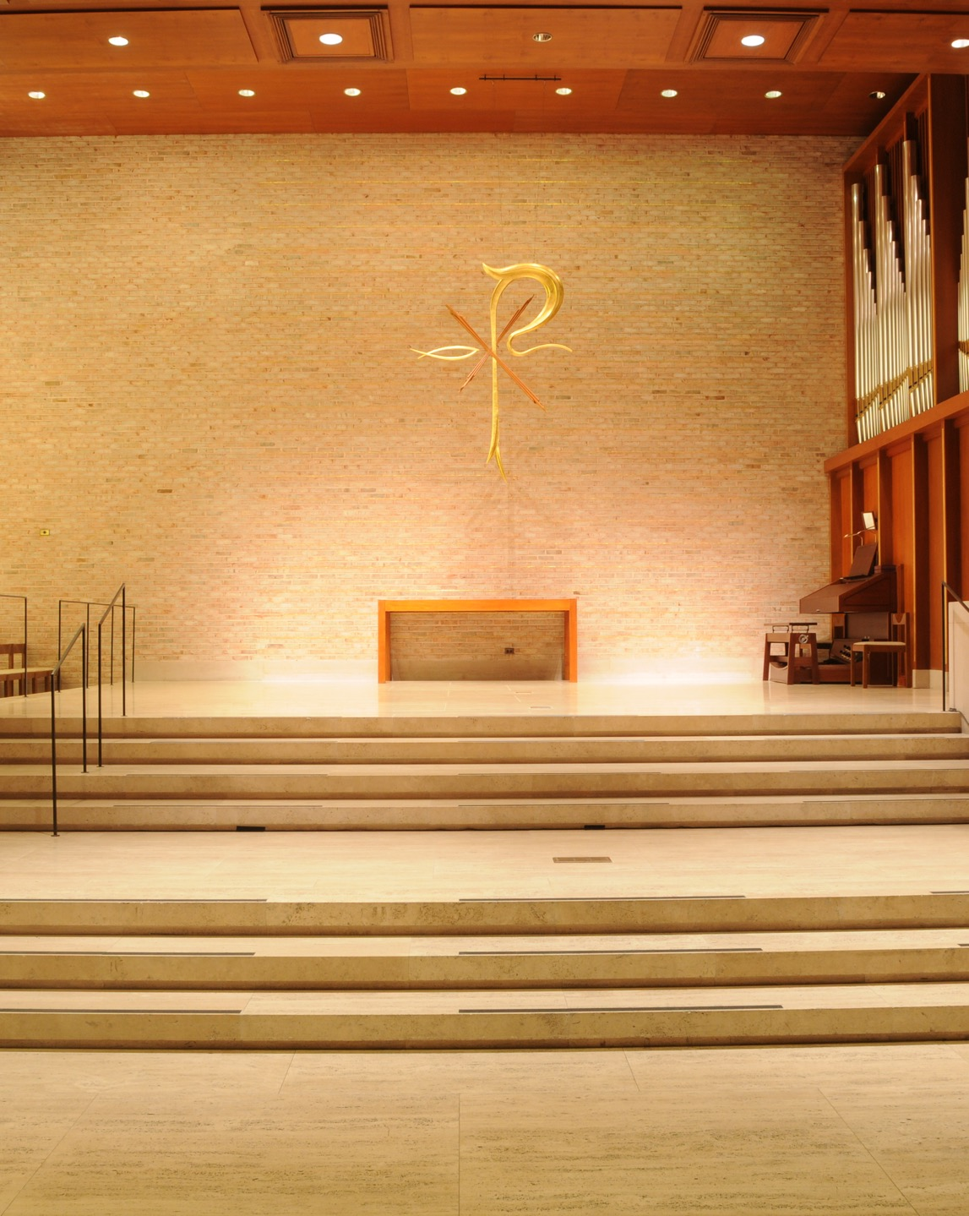

Succession & Legacy Planning__
Interchurch Center Conference
Thursday, November 10, 2022
The Interchurch Center
475 Riverside Drive at 120th Street
New York, NY 10115

Slide 2



LEGACY
Thinking and Planning for the future

Slide 3

Interchurch Center Conference
What are top action items you’re discussing with church clients seeking to invest funds for the future?

Slide 4
Projecting Investment Returns & Sustainable Distributions
Critical Issues for Fiduciaries Today

Slide 5





Call to Action
Click on icons to explore related content
Align your financial objectives with your investment implementation
Ensure that your allocation, IPS, and spending account for today’s starting point and are consistent with your goals
Analyze your inflation sensitivity
Your allocation, spending level, or income may be reason to initiate or increase an allocation to inflation sensitive assets
Right-size your cash allocation
We can explore a range of ideas, based on your return/risk objectives as well as time horizon
Revisit your alternatives exposure
Alternatives are a critical piece of a well-diversified puzzle and can help address lower expected market returns
Align your investment portfolio with your mission
Communities of faith are increasingly looking at their portfolios as additional capital that can be deployed in service of mission

Slide 6



New York Prudent Management of Institutional Funds Act (NYPMIFA)
General economic conditions;
The possible effect of inflation or deflation;
The expected tax consequences, if any, of investment decisions or strategies;
The role that each investment or course of action plays within the overall investment portfolio of the fund;
The expected total return from income and the appreciation of investments;
Other resources of the institution;
the needs of the institution and the fund to make distributions and to preserve capital; and
An asset’s special relationship or special value, if any, to the purposes of the
institution.

Slide 7
Interchurch Center Conference
When would NYMIFA apply to Religious Corporations?

Slide 8
Interchurch Center Conference
How Much Should We Hold In Short Term Reserves, and How Should We Invest Those Reserves?

Slide 9



Reserves Should Be Sized Based on Factors Impacting Shortfall Risk
Risk Factor
Revenue Risk
More Uncertainty or Potential for Disruption = More Reserves
Less Reserves Required Some Reserves Required
More Reserves Required
LESS
MORE
Spending Risk
Fixed Commitments or Potential for Spike = More Reserves
LESS
MORE
Timing Differences
Variability, Seasonality, or Timing Mismatch = More Reserves
LESS
MORE
Borrowing Risk
Access to Margin or Loan from Affiliate Org. or Donor = Less Reserves
LESS
MORE
Hypothetical client profiles presented. Historical analysis is not necessarily indicative of future results. There is no guarantee that any estimates or forecasts will be realized. Source: Bernstein analysis

Slide 10



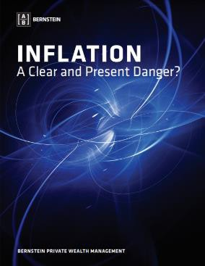
Inflation Sensitivity Is Critical to the Asset Allocation Decision
Key Takeaways from our Research
Less inflation-sensitive
More inflation-sensitive
Most should benefit, over time and to some degree, from inflation protection, but it’s more critical for some organizations than for others
Inflation is episodic so there will likely be a “cost” to the protection during sustained, non-inflationary environments
Low/No Revenue
Incoming Revenue
Asset Allocation to Bonds
More Bonds = More Sensitive
LESS
MORE
LESS
MORE
Revenue as Percent of Assets
Less Revenue = More Sensitive
LESS
MORE
LESS
MORE
Click Here
Spending as Percent of Assets
More Spending = More Sensitive
LESS
MORE
LESS
MORE
Hypothetical client profiles presented. Clients’ risk tolerances and bond allocations may vary. Based on capital markets conditions as of December 31, 2021..
Historical analysis is not necessarily indicative of future results. There is no guarantee that any estimates or forecasts will be realized.
Source: AB

Slide 11
Interchurch Center Conference
Why is inflation so important under NYMIFA?

Slide 12
Interchurch Center Conference
What are Alternative Assets, and Should We Be Investing In Them?

Slide 13
Institutions of All Sizes: Adoption of Alternatives and Inflation Protection
Wide Allocation Variations by Institution Size
 | Total Institutions | Over $1B | $501M - $1B | $251M - $500M | $101M - $250M | $51M - $100M | $25M - $50M | UNDER $25M
Total Institutions | 720 | 136 | 76 | 105 | 181 | 126 | 67 | 29
U.S. Equities | 12.78% | 9.89% | 24.27% | 25.19% | 30.90% | 38.56% | 40.87% | 38.02%
Non-U.S. Equities | 12.16% | 11.54% | 16.21% | 14.47% | 15.01% | 13.37% | 15.64% | 15.26%
Global Equities | 7.47% | 7.28% | 7.71% | 8.93% | 9.67% | 7.04% | 6.83% | 7.98%
Marketable Alternatives | 17.02% | 18.13% | 12.62% | 13.53% | 8.77% | 6.37% | 3.90% | 2.49%
Private Equity | 15.40% | 16.56% | 13.03% | 8.75% | 6.79% | 3.44% | 2.36% | 0.17%
Private Venture Capital | 11.77% | 13.42% | 4.52% | 3.91% | 2.01% | 1.28% | 0.63% | 0.52%
Fixed Income | 11.06% | 9.99% | 14.22% | 15.29% | 19.09% | 23.14% | 25.17% | 32.04%
Real Assets | 9.90% | 10.54% | 6.80% | 7.50% | 6.27% | 5.01% | 4.09% | 3.11%
Other | 2.45% | 2.66% | 0.63% | 2.42% | 1.48% | 1.78% | 0.52% | 0.41%
Source: NACUBO–TIAA 2021 Study of Endowments

Slide 14
Interchurch Center Conference
How Can We Better Align Our Investments With our Mission?

Slide 15
How Can We Better Align Our Investments With our Mission?
Investment Portfolio
Vendor Relationships and Purchasing Programs
Messaging and Donor Relationships

Slide 16
“Portfolios with Purpose” Are Designed to Pursue Financial Goals While Also…
...shaping the available issuer universe with explicit exclusions.
…incorporating an additional responsibility goal along with traditional risk/return.
…focusing on issuers who
meet present needs without
compromising the well-being
of future generations.
…aiming to produce a measurable social or environmental impact
with investments.
Screening
Goals-Based
Sustainable
Impact
Our investment strategies can screen out issuers, such as
weapons and tobacco firms
Our investment strategies can target specific goals, such as carbon neutrality
Our sustainable strategies align with the UN SDGs, focusing on health, climate, and empowerment themes
Our Municipal Impact strategy invests in bond projects that benefit underserved communities
UN SDGs: United Nations Sustainable Development Goals. Representative responsible investing strategies. Screening is available upon client request for separately managed accounts; investment minimums apply.
Source: AB

Slide 17
Interchurch Center Conference
What Else Can We Do To Help Grow Our Investments?

Slide 18
Fundraising and Revenues: Questions & Legal Obligation for Fiduciaries
How does fundraising factor into current and future cash flows?
How are you messaging the importance of additional financial support, particularly in times of transition?
How have you equipped your team?

Slide 19
Integration Helps Facilitate Success
Investments
Short term
Intermediate
Long horizon
Restricted vs unrestricted
Your
Mission
&
People
Revenues
Grants
Annual & Planned Gifts
Dues, tuition
Fees for service
Expenses
Fixed
Variable
Seasonal
Anticipated

Slide 20
Interchurch Center Conference
Succession: Entrusting your mission in a new entity.

Slide 21
Interchurch Center Conference
What is the difference between mergers and consolidations?

Slide 22


How to Prepare for Dissolution?
Ascertain all the assets of the Corporation
Ascertain all the liabilities
Determine how many assets will be left after the payment of all the liabilities
Plan who will receive the balance
Most Importantly: IT’S NOT OVER UNTIL IT’S OVER

Slide 23
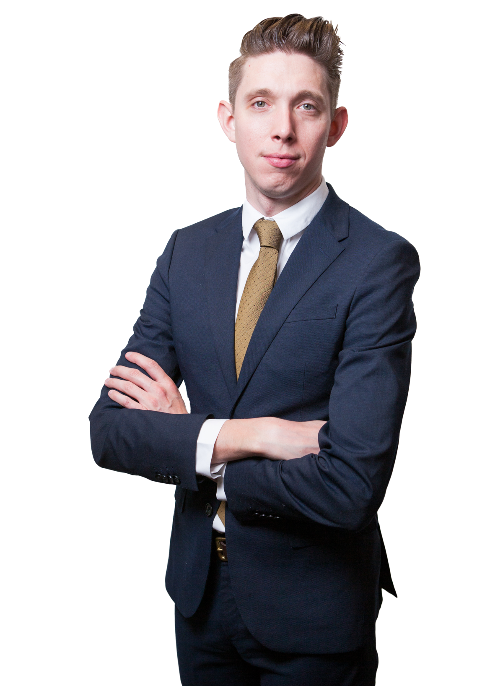

William McManus
Associate
Capell Barnett Matalon & Schoenfeld LLP
William McManus’ practice focuses on advising not-for-profit, religious, and tax-exempt entities on corporate governance, compliance with state and federal not-for-profit regulations, internal investigations, and regulatory enforcement actions. William is experienced in guiding New York not-for-profit, and religious corporations in their formation and governance and regularly advises clients on tax-exemptions and regulations of tax-exempt organizations. William also counsels clients on managing their assets, including charitable giving and endowments, with a strong emphasis on the real estate needs of those entities. In William’s real estate practice, he represents not-for-profit and religious corporations that are real property owners in complex, large-scale development transactions, including multifamily affordable housing, mixed-use projects, and other real estate developments. He also regularly advises on real estate acquisition, financing, and leasing.

